Slide 1
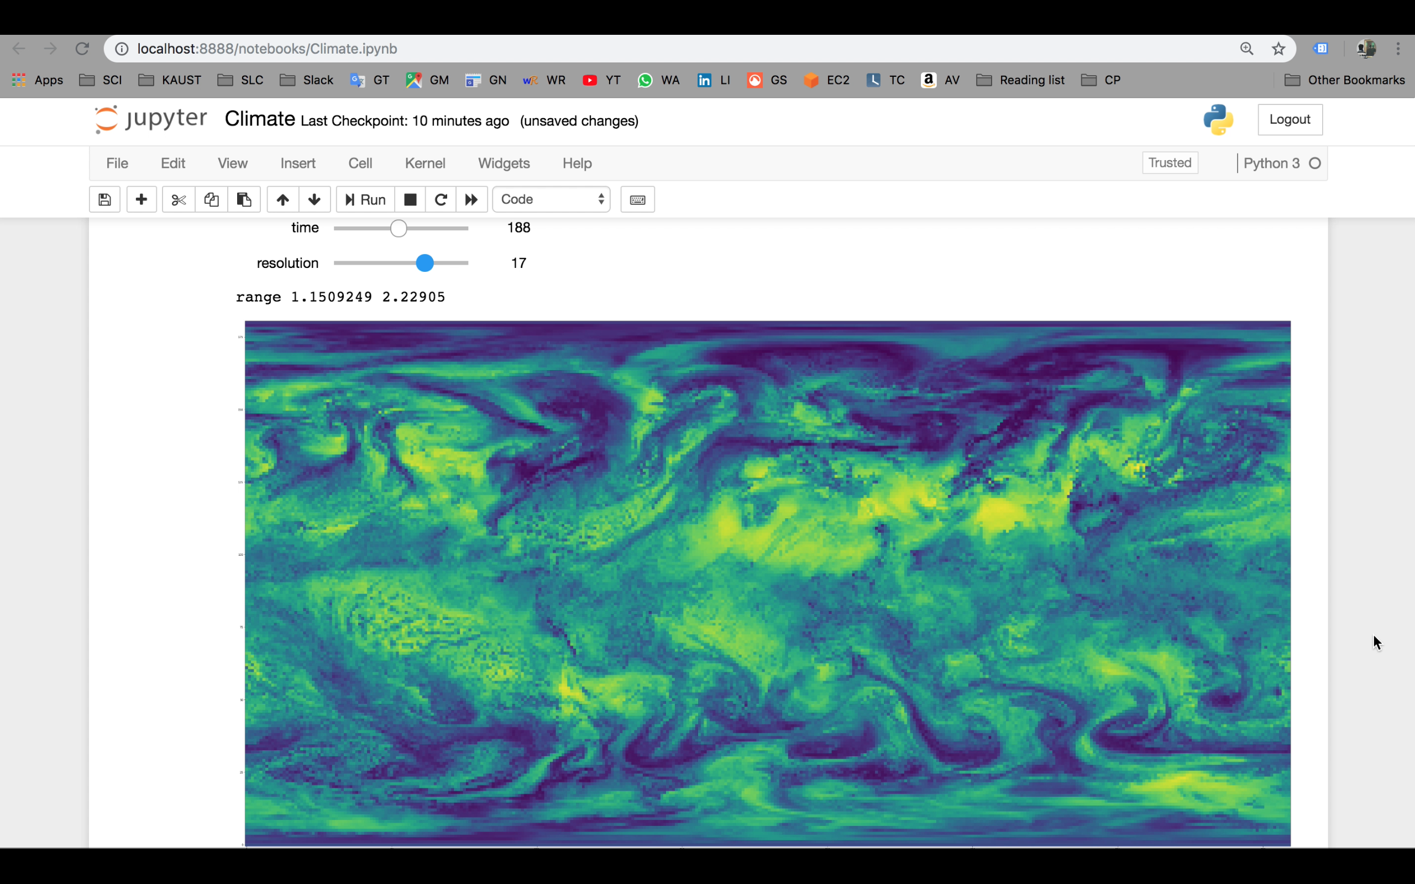
NSDF Server API and Python interface
We enable access and use of the streaming infrastructure from python (here Jupyter Notebook). All the data goes through Numpy arrays ad can be therefore processed as the user needs
Notes:
(old) webviewer and how to access and use the streaming infrastructure from python (using Jupyter Notebook), you can cut the video if you want
You can cat the first part of the video if you want and just show the jupyter stuff

Slide 2
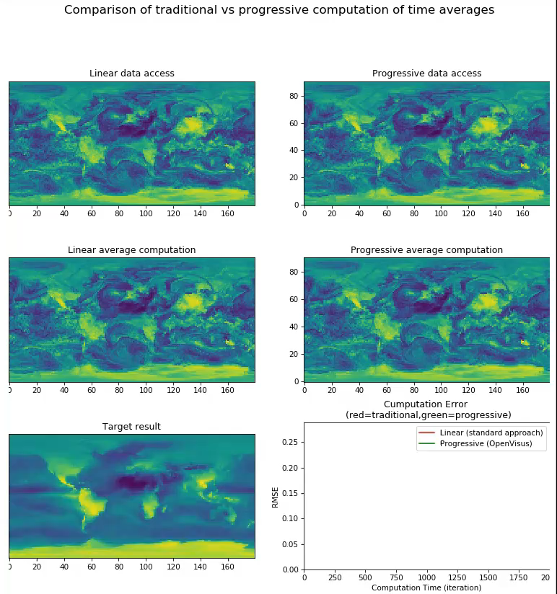
Streaming computation without explicit data download
Average over 2000 time steps
Data pulled on demand: coarse computations require less data movements (still cached for future use)
Progressive computation in space and time provides faster convergence

Slide 3
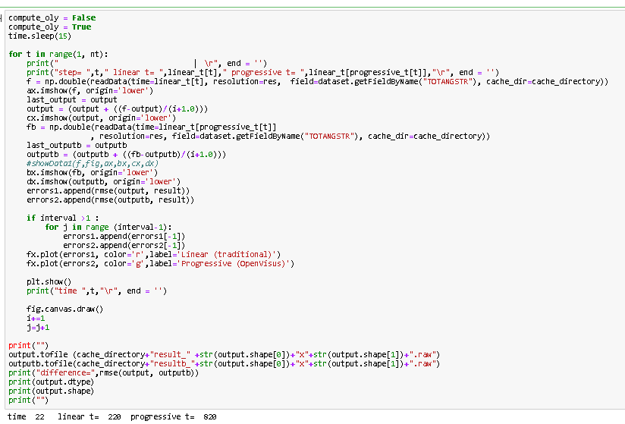
Streaming computation without explicit data download

